Slide 1
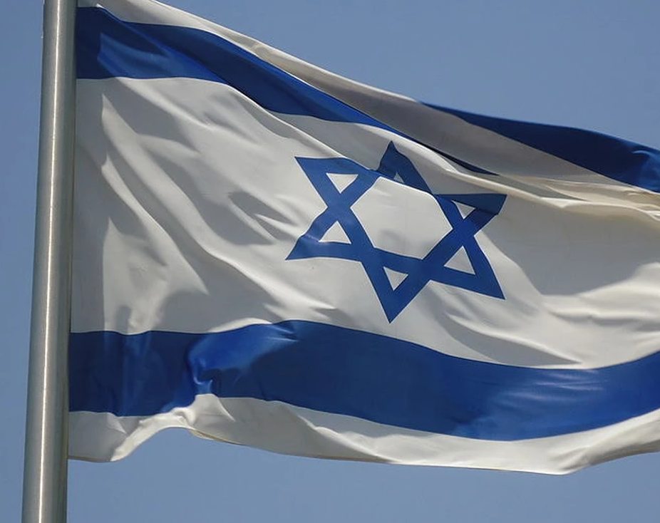
Proposed Constitution for the State of Israel
An Overview

Slide 2
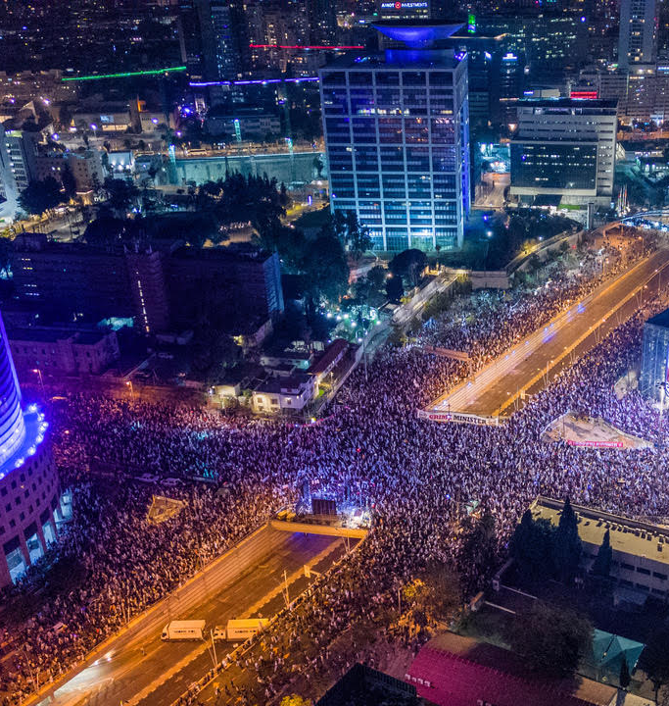

Why?
And Why Now?

Slide 3
Intense Need
In a world without a Constitution, everything is fair game
This has led to numerous issues within Israeli politics and different political groups maneuver to assemble power without any clear set of rules limiting what they can do.
  These political groups include both the Supreme Court and parties in the Knesset

Slide 4
Intense Challenge
Traditional Constitutions do not work in the Israeli environment.
There are three fundamental challenges:
  Israel was created to protect the Jewish people and yet it wants to be an open democracy. Trying to balance these forces had led to maneuvering to ensure a Jewish majority and a de facto system that gives tremendous power to that majority to protect itself. A Constitution would limit this and is thus difficult to accept.
  The primary dividing lines are not geographic. So traditional Constitutions that build on balancing geographically based divides (e.g. North vs. South or City vs. Rural) don’t apply. Thus, a useful balancing of powers is hard to imagine.
  The primary dividing lines are sectarian. However, societies with these divides (such as Lebanon) have never had well-functioning Constitutional systems.

Slide 5
Acute Crisis I
With the changing of the democratic majority from secular, European, Jews to more religious, Middle-Eastern Jews, a fundamental cultural power struggle has emerged.
The secular, European, Jews want to preserve their values, but in a system built on the majority having overwhelming power, they face fundamental challenges.
If this isn’t solved, the continuing emergence of a religious democratic majority will necessarily conflict with the secular and liberal minority seeking to preserve its power.
The current system can’t contain these two forces in their emerging realities.

Slide 6
Acute Crisis II
With the evolution of effectively separate systems for different ‘sects’ within Israeli society, cross-cultural communication has been limited.
This has been accentuated by political parties that narrowly serve groups that are all-encompassing in a way that extends beyond mere politics.
If this isn’t solved, the society will pull itself apart.
Presently the first crisis (sectarian dominance) and the second crisis (sectarian separation) are feeding on each other.

Slide 7
Acute Opportunity
The very flux we’re experiencing creates an opportunity for a broad solution.
Some polling has indicated that up to 80% of the population opposes the Judicial Reforms and 80% have never attended a protest.
  There is massive political opportunity and demand for something new.
  The greater disruption of the protest movement is not attracting new converts – it is just driving more people into a political no-man’s land. This is why Benny Gantz’ party, which takes a centrist position, has seen the greatest gains.

Slide 8
Acute Opportunity
A Constitutional proposal would give form to the ‘centrist’ position. Rather than just weakly emphasizing compromise it could strongly emphasize a positive path forward.
Those who headline a proposal that doesn’t take sides in the current debates could be massive political winners while fundamental serving the State and the People.
Periods of great challenge are periods of great opportunity – and we are facing one today.

Slide 9
The Constitutional Solution
This Constitution aims to integrate the great challenges to an Israeli Constitution by:
  Recognizing reality
  Protecting minorities
  Protecting the global Jewish population
  Moderating political forces by encouraging cross-sectarian political interaction
It this in a way that doesn’t take sides on the great disputes of our day.
The unique concepts that enable this to occur are:
Streams (זרמים) and Clusters (קבוצות)

Slide 10
A Fundamental Tension
We are being pulled apart by our different ways of life… and yet we need to be pulled together, despite those different ways of life.
This Constitution is about enabling both to occur.

Slide 11
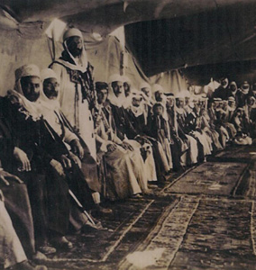
Distinct Lives for Distinct People
Streams & the Constitutional Assembly

Slide 12
What is a Stream (זרם)?
One fundamental innovation in this proposed Constitution is the idea of Streams (זרמים)
A Stream is like a geographic state, province or prefecture – but it is not geographic.
  Like States, Streams have:
    Their own Constitutions
    Their own budgets for welfare and education
    And their own civil law systems (which only affect cases that have no impacted parties outside the Stream)
  Unlike States, Streams do not have:
    Their own tax revenue
    Their own criminal law systems
    Their own territory
  A member of a Stream can live anywhere
  People can change Streams
A Stream is not a Sect or Ethnicity.
  Streams can be formed around any grouping, including broad ideological groupings.

Slide 13
How is a Stream formed?
A Steam must produce a Constitution that delineates how it will govern its own affairs.
Every 10 years the entire population can select what Stream they belong to by order of preference. This is an opportunity for new Streams to form or old ones to dissolve.
A Stream must have more than 100,000 members. If it has less, those who chose it are shifted to their next preference.
Expected streams might include Haredi, Mizrachi, Muslim, Christian, Druze, Chofshi (Liberal) and Dati.

Slide 14
Powers of a Stream
If a new stream is created, it has two years before it comes into force at which point it becomes responsible for education, welfare and civil law for its members.
A Stream also has representatives in the Constitutional Assembly.
  Every Stream starts with 2 members in the Assembly, with 1 more added for each 500,000 members. This gives smaller Streams more representation. It protects minorities.
  There is a counter to a proliferation of small Streams. If you want to be under a civil law system of a particular sort (say Haredi or Sharia) then that system only applies if all parties are in the same stream. If there is a Chassidic and Litvakish stream then all disputes between members of those Streams would fall into the national courts.

Slide 15
Powers of the Constitutional Assembly
The Constitutional Assembly can:
  Approve judges (51% for lower-court judges, 66% for Supreme Court)
  Change the Constitution (75% approval)
  Dismiss members of Knesset (75%)
  Select the President (51%)
  Override the Supreme Court (66%)
Because the Assembly overrepresents minorities, minorities are protected in this forum. This gives greater power to future minorities – so the Jewish people can protect their Constitution even if they are a minority.

Slide 16
Special Voting Considerations
The Constitutional Assembly has a weighted voting system that gives somewhat greater voting power to those streams who make their members available for military and/or national service (e.g. are more invested in the State).
Members do not have to serve; they just have to be available. So, Arab Muslims could make themselves available for the Army or National Service and would see voting benefits as a result, even if the Army did not draft them.
A smaller Charedi Stream that refuses service would see some of their ‘small stream’ benefits eroded.

Slide 17
The Knesset Role
In the areas of education and welfare, the Knesset would allocate funds on an economic and population basis alone. There would be no ‘micro-allocation’ based on particular interest groups.
The Streams would have access to the funds effectively budgeted for their members and would use their own governments to apply the funds.
Political combat in these areas would be moved off the Knesset board.

Slide 18
How would it work?
Streams would be established and if they did not serve their members well then people would leave them at the next cycle. This is akin to leaving California and moving to Florida.
This would create a constant competition for better governance in the areas the Streams affect.

Slide 19
Streams Recognize Reality
Israel already has Streams.
  The Arab and Charedi world already effectively have law and educational systems that are quite distinct from those of the State.
  The Gemach system extends that to welfare within the Charedi world.
A Stream-based Constitution would just recognize and formalize reality, thus making for a more stable government that brings peripheral groups into the system.

Slide 20
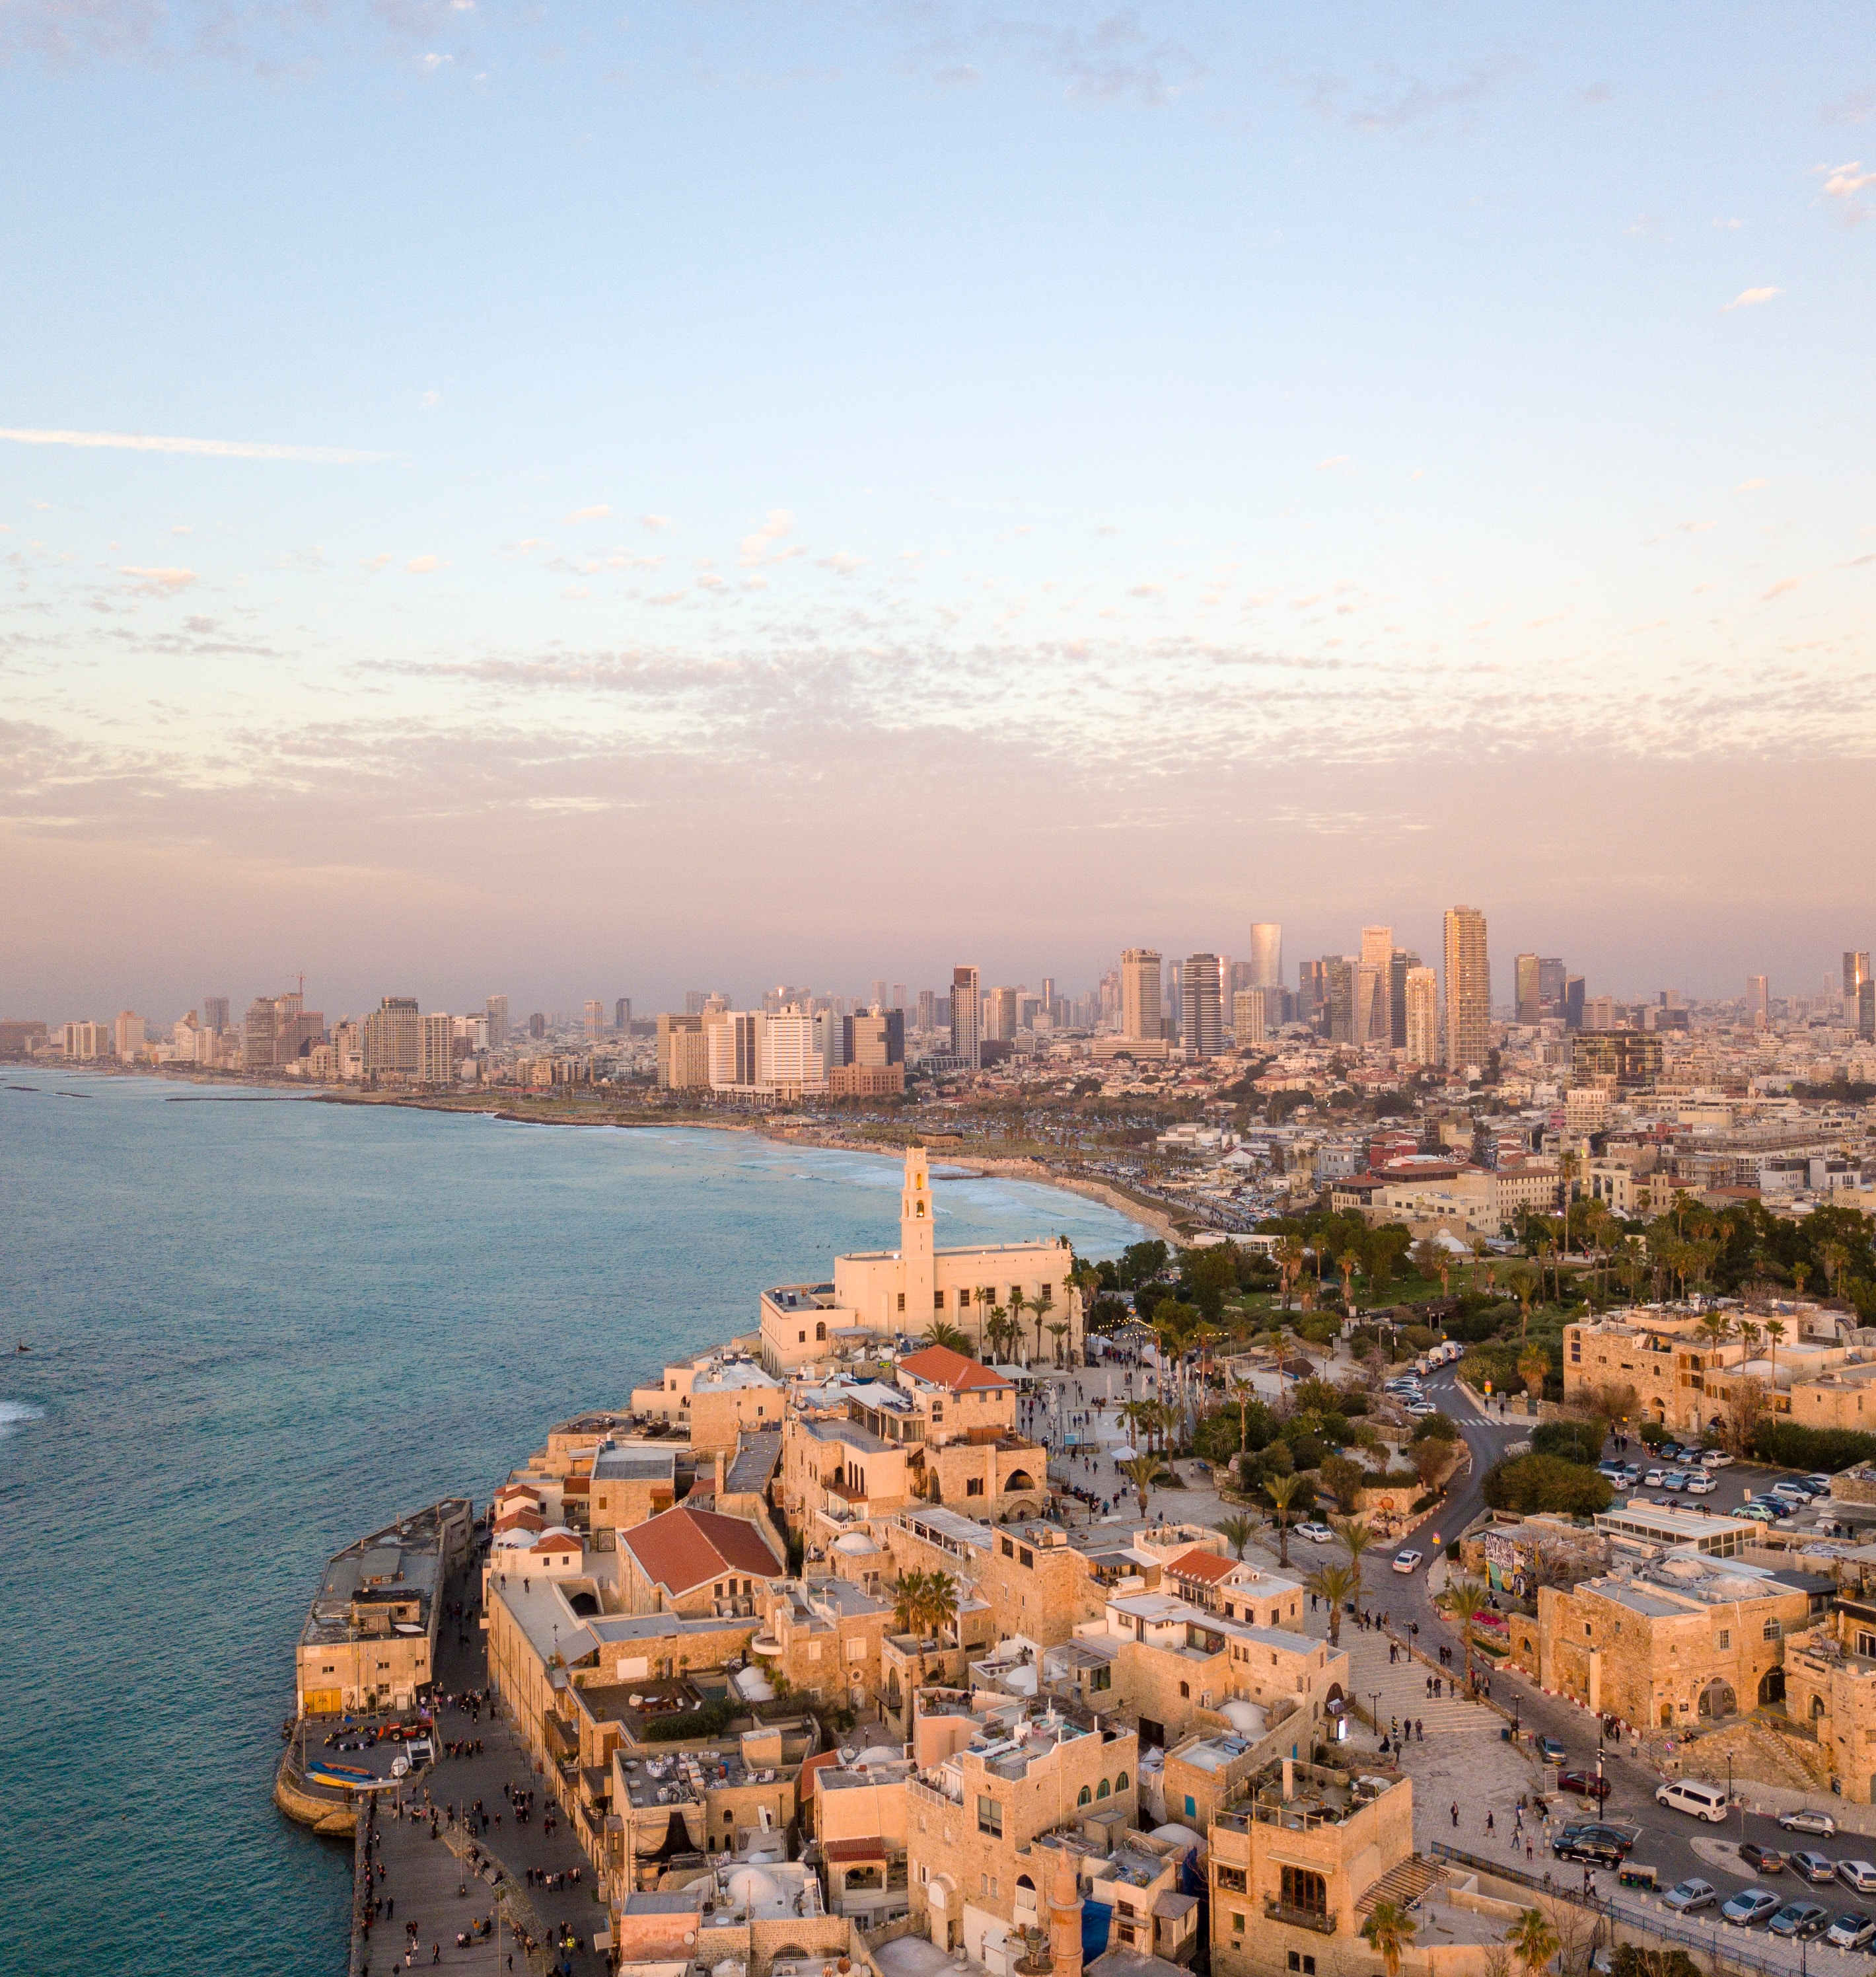
Building Bridges across Cultures
Clusters & National Moderation

Slide 21
Clusters Draw Us Together
Israel’s current Knesset system favors parties that speak to the needs of a particular percentage of the population.
This gives a national platform to extremists of various stripes and does little to draw the nation together.
Some modern States create moderation by allowing only the highest vote receiver over a diverse geographic area to assume office. This mutes extremists who can not achieve electoral success across such a population.

Slide 22
What is a Cluster
Clusters build on Streams, but act in tension with them.
A Cluster is made up of citizens from different Streams in equal proportion to those Streams representation in the general population.
  If 20% of the population belongs to a Muslim Stream, then every Cluster would have 20% Muslim Stream members.
Clusters are assembled around each of the largest 150 Statistical Areas as defined by the Central Bureau of Statistics.
  This means Clusters are loosely geographic, while also encompassing the full spectrum of streams.

Slide 23
What does a Cluster do?
The highest vote receiver in each Cluster joins the Knesset.
This favors politicians who can reach across boundaries and appeal to:
  People broadly in their geography
  People across Streams
All non-Constitutional State laws require Knesset approval – but Knesset members will be incentivized to support wider populations.
Knesset members will also represent their own constituents – creating a bond of responsibility between politicians and citizens.

Slide 24
How does a Cluster Moderate?
Clusters do not only create more moderate politicians, they encourage cross-Stream communication.
A Cluster based in a Tel Aviv Statistical Area may well need to draw on citizens from Bnei Brak, Jaffa and Lod, one based on Modiin is also likely to include members from Modiin Illit, Ramle and other areas while one based in Nazareth or Umm-El-Fam would include members from nearby Jewish settlements.
Successful political activities will naturally reach across Sectarian lines.

Slide 25
Streams & Clusters
Streams and Clusters will be in constant – balancing – tension.
Streams will have Stream-focused mini-Constitutions, civil, educational and welfare systems. They may be very very distinct while they serve the national population of a Stream.
Clusters will reach across all Streams and form the backstop of laws that apply in any cross-stream or criminal cases while guiding national laws and policy.
Distinct lives enabled even as the Constitution brings people together.

Slide 26
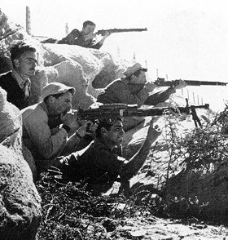
Jewish Protection
Protection of a Persecuted People

Slide 27
The Cultural Identity Distinction
The text of the Constitution says:
  “As the State of Israel has been established to protect the Jewish people from persecution, and in reaction to genocide in the Christian majority world and ethnic cleansing in the Muslim majority world, Jewish Cultural Identity shall provide for two specific rights.”
Those rights include:
  The Right of Return
  The exclusive right to head Tzahal, Mossad and Shabak.
These rights exist purely to protect the Jewish people. They do not result in greater representation in the Constitution Assembly or Knesset or the reservation of any other position including Prime Minister, President or Supreme Court.

Slide 28
Who is a Jew?
The Constitution takes this out of the hands of the religious courts.
For State purposes, the definition of a Jew is handled by a special committee with rolling membership elected by those recognized as having Jewish Cultural Identity.
This has no religious bearing.
If the Committee decides to extend Jewish Cultural Identity, the only impact is to indicate who is eligible for immigration and the most senior Army and Intelligence service roles.

Slide 29
Recognizing Reality
While it would be best not to have any such distinction, this clause also recognizes reality.
The Jewish people need protection – but not supremacy.
The Jewish religious courts also often strongly disagree with secular authorities on who should be considered a Jew. The reality is that the ethnic and religious definitions vary widely and separating the two will make each more stable.

Slide 30
International Standards
Various Constitutions have special rights for those who share aspects of cultural identity. For example, coming from a French-speaking country and speaking French as a mother tongue is important in becoming a French citizen. The Spanish have similar clauses.
  These positive rights are expressed by the right of those with Jewish cultural identity (as defined by the special committee) to immigrate.
Many systems effectively have negative rights for those who aren’t part of the culture, but hide them. Being born in Germany or Japan isn’t enough to be a German or Japanese citizen with all the rights that entails. These countries protect their Cultural Identity by denying a wide range of rights to those who don’t share it.
This Constitution attempts to make the rights of citizenship as broad as possible while still serving the critical protective role for the Jewish people.

Slide 31
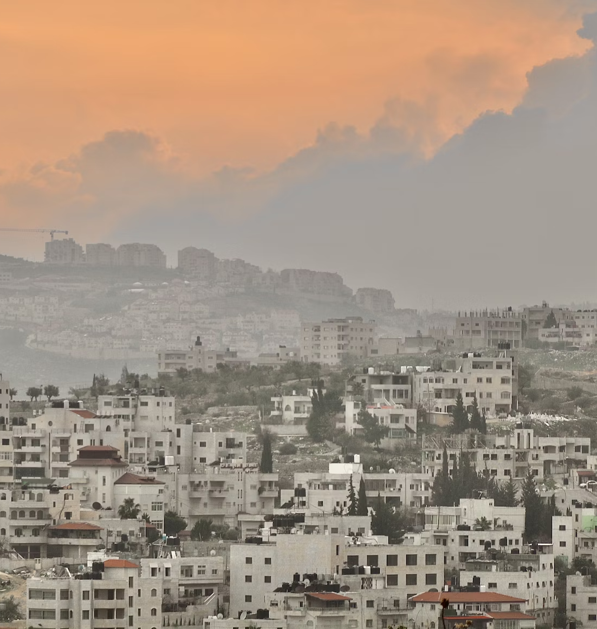
Palestine & Settlements
A Multi-Stream State

Slide 32
Living in Fear
Israelis have long lived in fear of an Arab majority.
Whether or not the Arab population was willing to accept a Jewish state, an Arab majority would spell the end of Jewish protection and self-rule.
This demographic reality is one force that has limited Israeli willingness to extend citizenship to those who identify as Palestinian.
Other critical forces include:
  Resistance by Palestinians to being part of the Jewish State
  Concern that Palestinian citizens will be a fifth column that will undermine the State

Slide 33
The Constitutional Approach
This Constitution does not eliminate these challenges.
It does offer a roadmap to making them better.
Municipalities and their territories can choose to join the State of Israel after a three-year probationary period if:
  80% vote to do so.
  They hand over those suspected of crimes against the State, Streams or the Jewish cultural identity for criminal prosecution.
  Their education system eliminates incitement against the State, Streams or the Jewish cultural identity for criminal prosecution.
  They establish borders.
Municipalities can also leave the State of Israel. If Umm El-Fahm wants out, they can elect to leave simply through an 80% vote.

Slide 34
The Constitutional Approach
These provisions serve as a pressure valve on the conflict. Those who really want out of Israel can leave and those who want out of the conflict can join the state with their residents picking the Streams that honor their self-determination.
There is no rule that excludes them on the basis of ethnicity, religious etc…
As a critical protection: even if Arabs form a majority of the state:
  The Constitutional Assembly will require other Streams to accept and approve any significant changes to the State.
  The Army and Intelligence Services will continue to be led by those with Jewish Cultural Identity.

Slide 35
Balance
Critically, this method of integration also gives a way for Jewish settlements to annex themselves to the State.
It thus provides benefits for both Jews and Palestinians – so long as they are willing to accept and be part of the multi-Stream State of Israel.

Slide 36
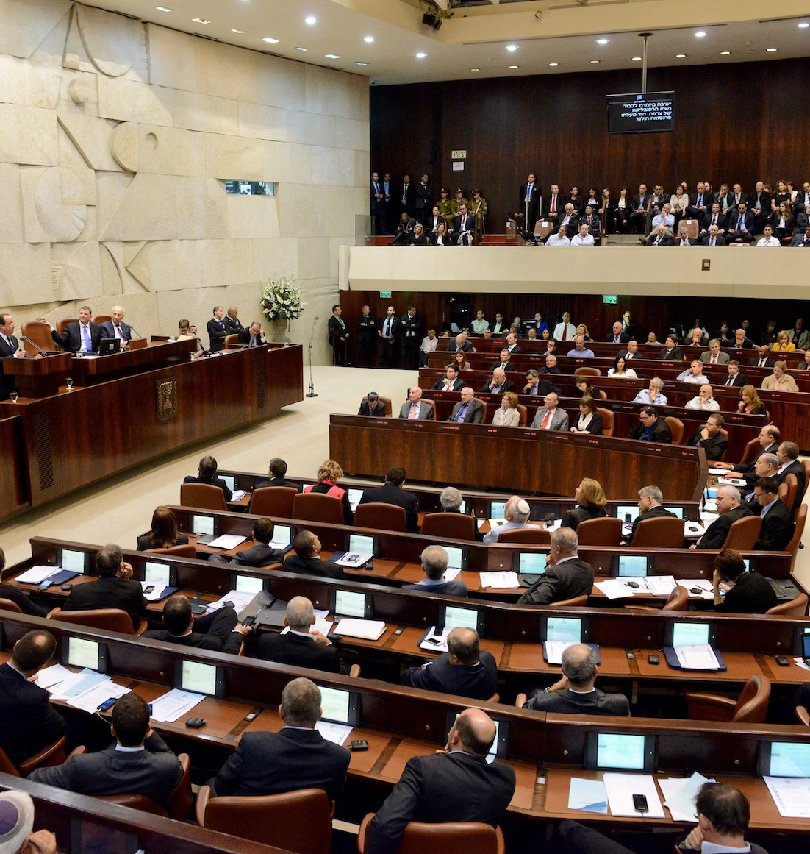
The Rest
A Conventional Constitution

Slide 37
Courts, President, Prime Minister & Knesset
The Constitution is very conventional in the power is grants the various branches of government.
Much of the content is copied from the Japanese Constitution (which was composed largely by the occupation American administration of McArthur).
The Supreme Court has a role as an adjudicator of law – but not a Legislature.
Its decisions can also be overturned by a 66% vote in the Constitutional Assembly – which requires wide agreement across society.

Slide 38
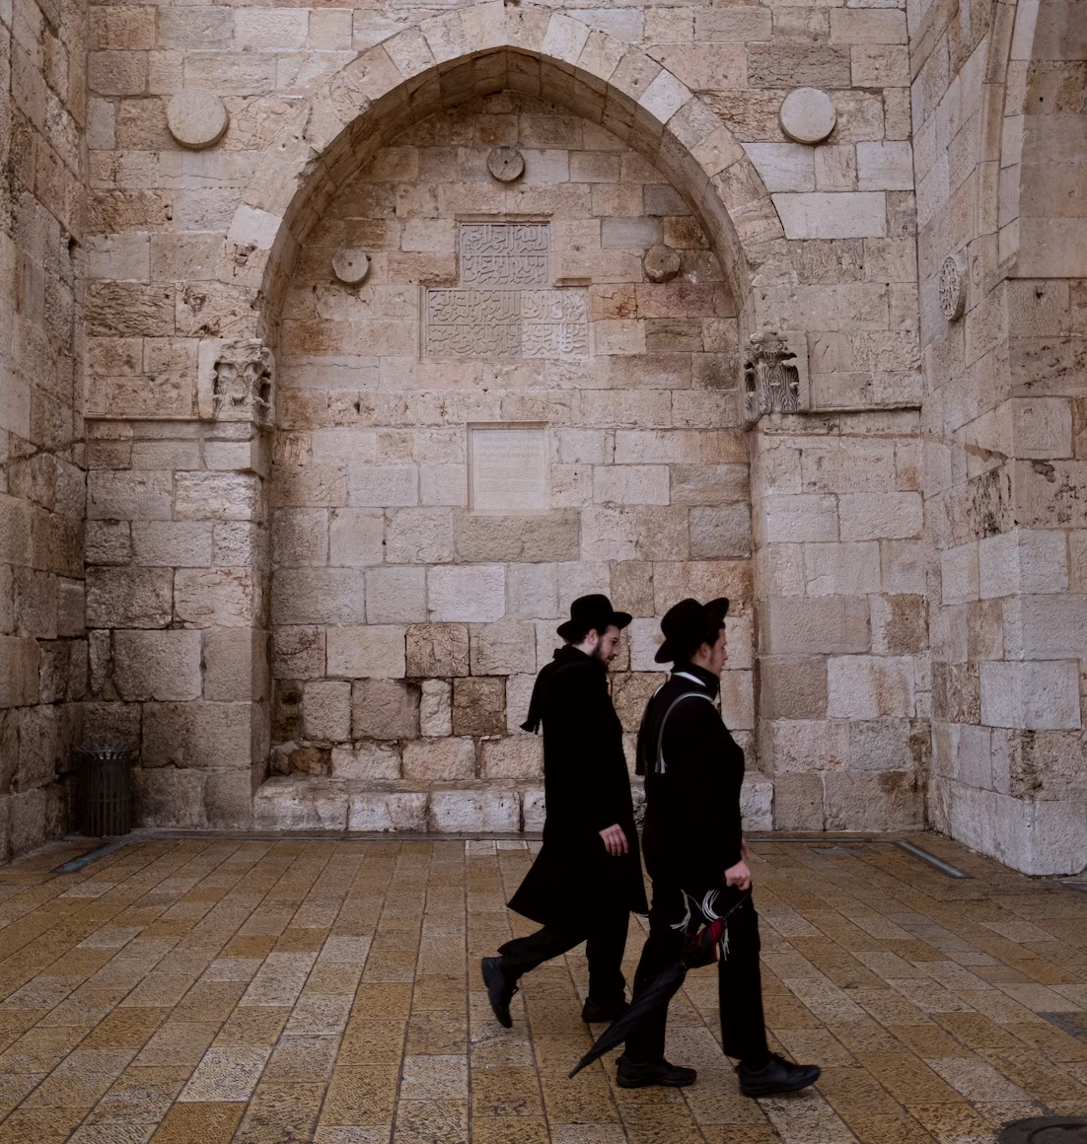
Risks
Common Concerns

Slide 39
Breakup of Society
With their own Streams, the sectors in society might drift further from each other…
The society is already fracturing.
This Streams alone sew it together by making different systems a part of the system.
Investing Streams with power also invests them with responsibility and loyalty to the system that has granted them that power.
Finally and most critically, Clusters bring the Streams for the regular business of government.

Slide 40
Education
Self-control of education might lead to people not meeting state standards?
Again, this is already happening. Part of this running from the State is due to concern about the State becoming overbearing. By carving out space for different Streams, the Streams can become less defensive.

Slide 41
Lack of Standards
Different definitions of terms like marriage and family can threaten the State
Quite the contrary – these different definitions already exist and the majority/courts desires to enforce a single understanding is threatening it.
By limiting the definition of families on a State level (perhaps allowing a simple economic definition of family groups no matter who the members are) these issues can be sidestepped in a future Knesset while allowing Streams to deal with things as they see fit.

Slide 42
Lebanon
Codifying the role of Streams could lead to a gridlocked situation such as in Lebanon
Lebanon guarantees particular jobs to particular sects based on very out of date census data. This limits ethnic roles purely to military roles – otherwise everyone is equal.
Lebanese sects are both ethnic and rigid. The Streams in this Constitution allow people to change and to self-define on terms other than ethnic terms.
  I expect the Chofshi (Liberal) Stream to be the largest because most people will want to live under such a system – whether Muslim, Christian or Jewish.

Slide 43
Municipalities
Could Municipalities be Stream-based?
There is no provision for Municipalities being governed by Streams. The whole point of a non-geographic Stream is that is allows mixing of different streams within single geographies and thus a more vibrant society without hard and fast lines between people.

Slide 44
Rights to X, Y and Z
This has no guaranteed rights to healthcare or basic income or…
By not codifying particular political beliefs, this Constitution becomes more viable. It is not attempting to grant any ideology a permanent ‘win’.
The goal is to create a stable playing political field that respects the reality of different Streams – not create a reality that will not be embraced.
Streams can certainly codify more ‘positive rights’ within their Constitutions.

Slide 45
Split Stream Families
What happens if a husband and wife choose different Streams?
The Constitution has provisions for this reality, including the assignment of Streams to children.
If a woman wants to leave the Haredi or Chofshi Stream, for example, she can. All disputes between her and her husband (or involving their children) would then be heard in State Courts rather than Stream Courts. The clarify of court selection does not exist today.
Streams choices don’t have to be made public. This enables a safety valve for a woman concerned about her safety/relationship.

Slide 46
Special Courts
Do Streams need Special Courts?
No, a Stream can choose to use the default State Court system.
However, the management of education and welfare will remain within the Stream.

Slide 47
Viability
This can’t possibly pass because…
By virtue of effectively falling outside every political and ideological persuasion in Israel, I can take the perspectives of various persuasions into account.
The strong need for a Constitution should make this not only viable, but desirable.
Streams want this autonomy, and its presence enables other issues – like those of the balance of Court and Legislative power – to be settled with a little less loser-loses-all attitude.
This approach offers a very strong path to viability.

